Slide 1
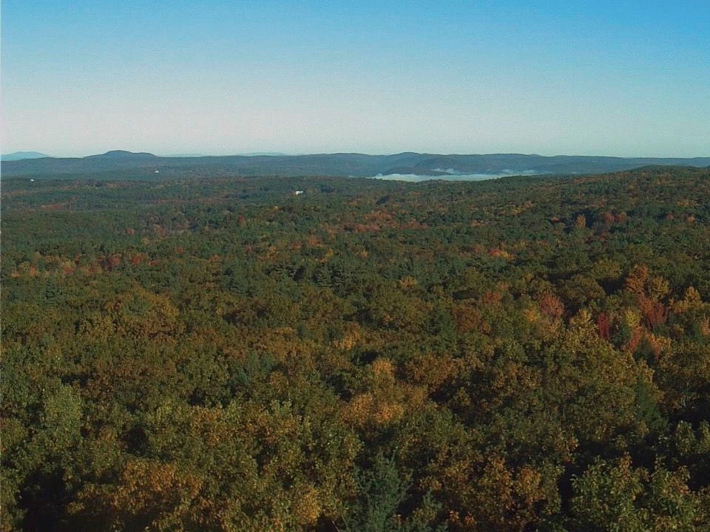
The PhenoCam Network: Tracking phenological responses to global change using near-surface remote sensing Andrew D. Richardson Northern Arizona University
AmeriFlux Early Career Workshop
Boulder, CO September 17, 2019

Slide 2
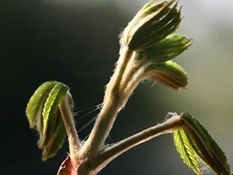
Phenology is “the scientific study of periodic biological phenomena, such as flowering, breeding, and migration, in relation to climatic conditions.”

Slide 3
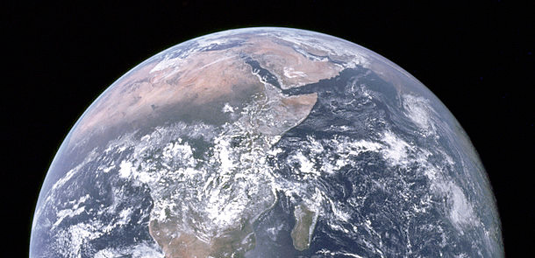
Why do we care?
Plant phenology is a leading indicator of the biological impacts of climate change
Plant phenology regulates the seasonality of ecosystem processes and biosphere-atmosphere interactions

Slide 4
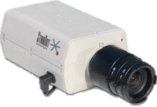
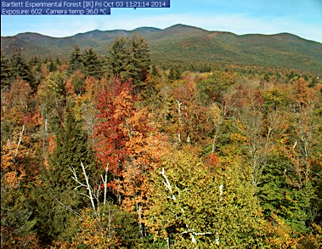
The PhenoCam Network: Near-surface remote sensing of vegetation phenology
PhenoCam uses imagery from networked digital cameras for continuous monitoring of plant canopies
Images recorded every 30 minutes, sunrise to sunset, 365 days a year
Processed to daily (or 3-day) measures of canopy greenness, from which seasonal transition dates are extracted
Bartlett Experimental Forest
Notes:
So the PhenoCam network does what we refer to as
***
Tower-based flux measurements, stand-level forest inventories, and small watershed measurements
So this gives us a direct link…

Slide 5
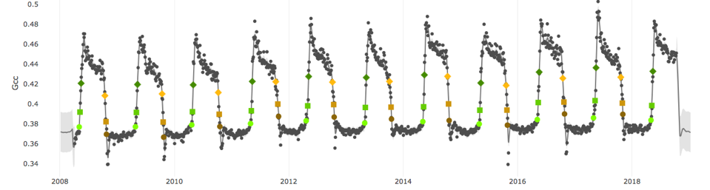
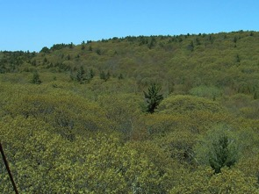
Ideal for long-term monitoring
Canopy-scale perspective is comparable to that of tower-based flux measurements
Harvard Forest EMS Tower
Potential to resolve organism-level phenology: a direct link between what is happening on the ground (fine scale) and what is seen by satellites (coarse scale)

Slide 6
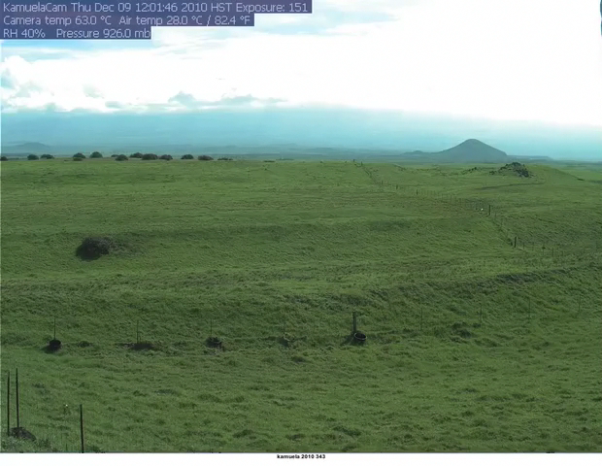
The same method works in other ecosystem types
Canopy greenness
Mixed, C3/C4 Grassland at 3000’ on the western flank of Mauna Kea, on the Big Island of Hawaii
Seasonality of vegetation greenness driven by timing and magnitude of precipitation events
KamuelaCam, Waimea
Notes:
The same approach is also able to track seasonal changes in greenness of other types of vegetation. So for almost seven years we have had a camera looking at a mixed C3/C4 grassland located at 3000 feet on the western flank of Mauna Kea, on the Big Island
Here, seasonality is driven by the timing and magnitude of precipitation events, and as you can see there is substantial year-to-year variaibility in the frequency and duration of green-up pulses, and again we’re able to track that, automatically and at high temporal resolution, using Phenocam imagery

Slide 7
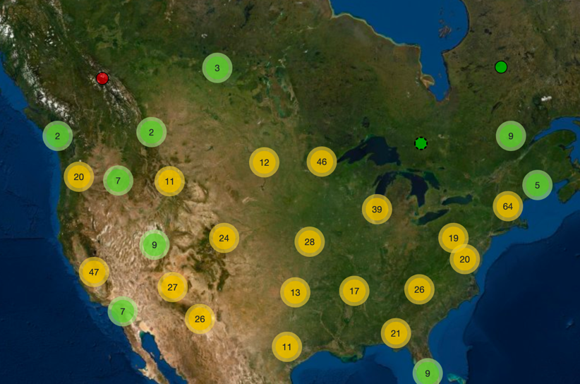
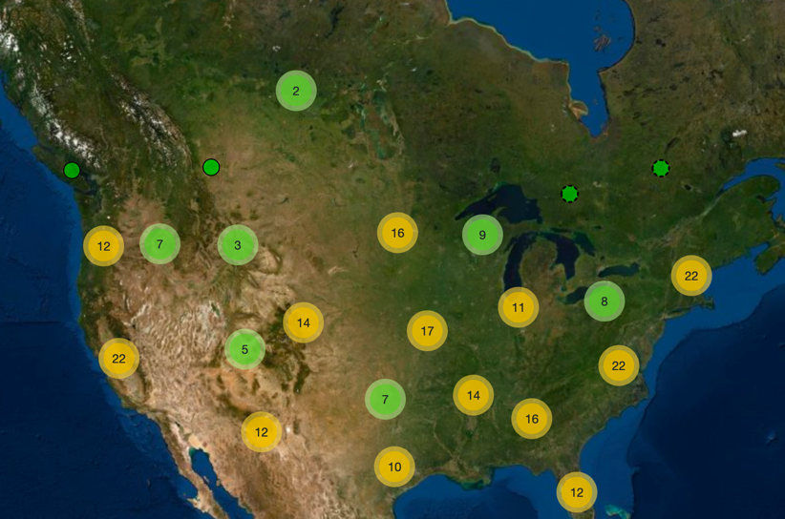
2019: A network of over 500 cameras
Imagery and data available at: http://phenocam.sr.unh.edu/
Notes:
So we now have over 500 cameras contributing imagery to the PhenoCam dataset. Most of these are lcoated within the United States, and we have cameras across the country, from Hawaii to Maine and from Alaska to Florida, as well as cameras in Canda, Panama, and a number of countries in Europe.
The imagery and data from these cameras is all publicly available through our web page…

Slide 8
Almost 300 these are actively measuring fluxes
Over 200 of these sites are affiliated with AmeriFlux
https://phenocam.sr.unh.edu/webcam/network/search/?group=AMERIFLUX https://phenocam.sr.unh.edu/webcam/network/map/?group=AMERIFLUX

Slide 9
In today’s workshop
How to access PhenoCam data products
How to visualize PhenoCam data in R
How to integrate PhenoCam and AmeriFlux data

Slide 10
Intro ends here

Slide 11
Accessing and Using PhenoCam data products Bijan Seyednasrollah Northern Arizona University
AmeriFlux Early Career Workshop
Boulder, CO September 17, 2019

Slide 12
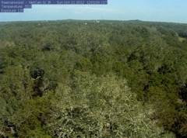
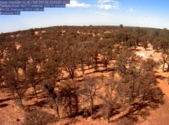
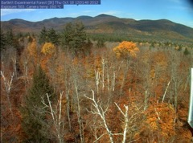
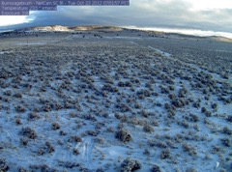
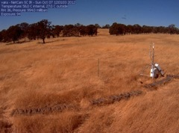
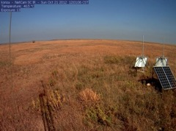
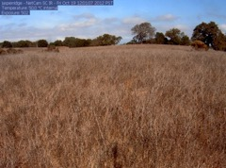
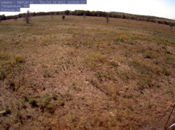
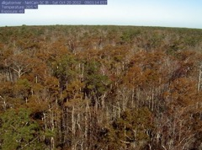
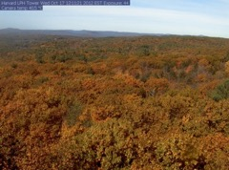
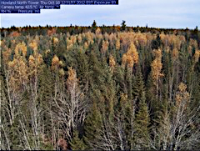
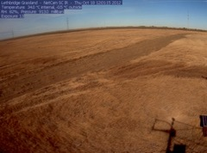
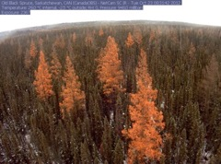
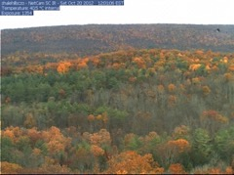
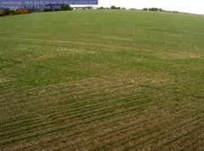
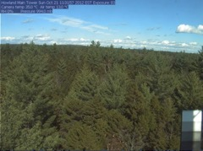
Notes:
Here are sample images from a variety of ecosystem types, including grasslands and prairie, savannah and shrublands, deciduous and evergreen forests, as well as agricultural crops.
Our ultimate goal is to have a comprehensive sampling of all the diverse ecosystem types of North America.

Slide 13
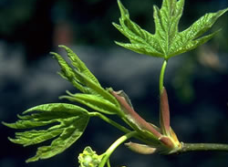
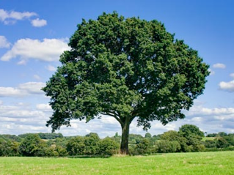
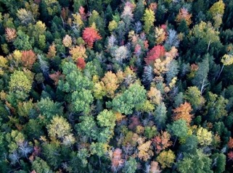
Research questions we are addressing with PhenoCam data
What are the environmental drivers of phenology?
How will phenology shift over the next 50-100 years, and how does this vary among ecosystems and climate zones?
What is the role of phenology in regulating ecosystem carbon and water cycling?
What is the impact of phenology on land-atmosphere interactions and feedbacks?
Notes:
There are four key questions that my group’s research targets

Slide 14
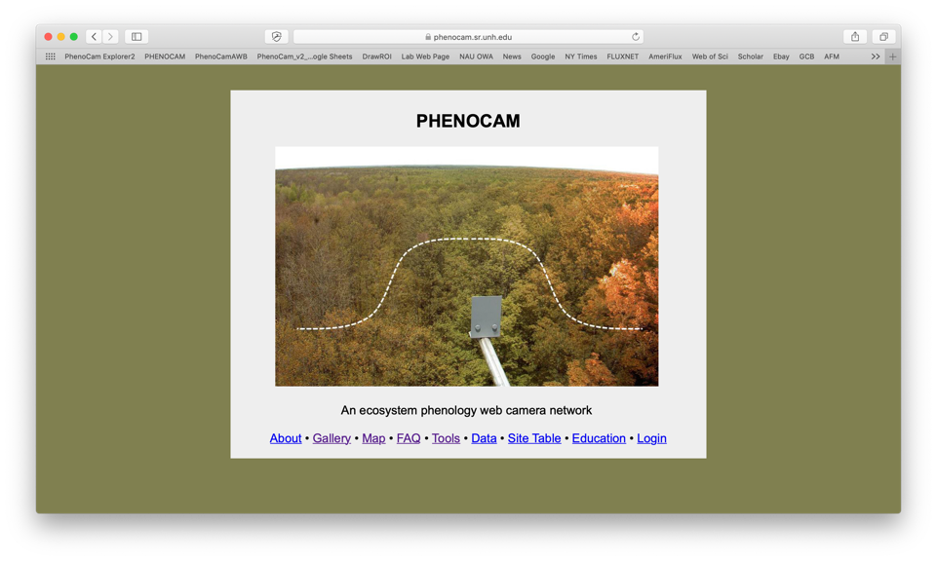
http://phenocam.sr.unh.edu/

Slide 15
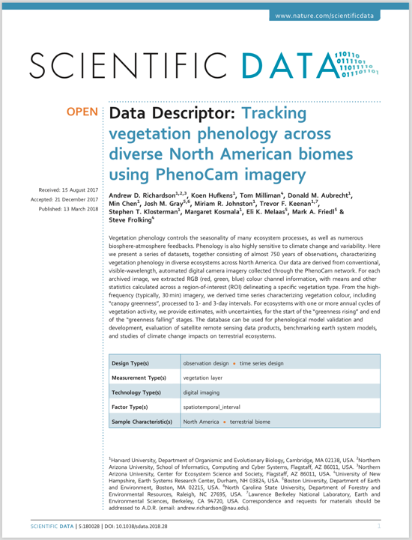
PhenoCam Dataset Releases
V1 .0 Fully documented (2018) in Scientific Data
125 sites, 750 site-years, fully processed and quality controlled
Data and imagery posted to ORNL DAAC
Available under CC0 Public Domain Dedication
V2.0 Dataset has just been released (1850 site-years of data); Data Descriptor in press
Notes:
In addition to making our data publicly available through the phenocam web page, we recently put together and documented a curated data set of PhenoCam data – consisting of data from 125 sites and a total of 750 site years
**
**

Slide 16
http://explore.phenocam.us/

Slide 17
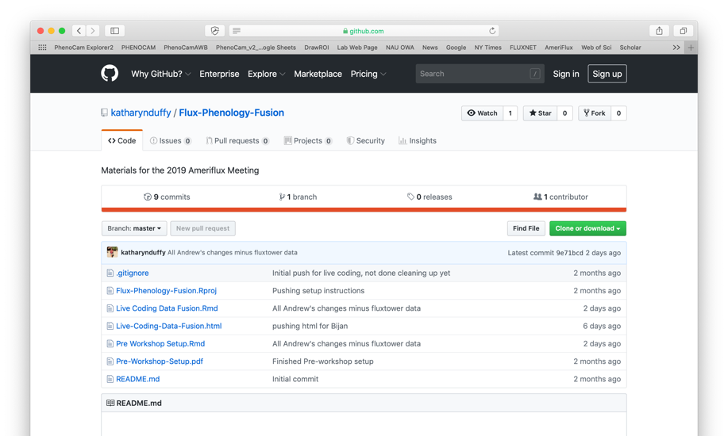
https://github.com/katharynduffy/Flux-Phenology-Fusion

